Slide 1
AWS Relational Database Service
In this Project, I will walk you through the process of creating and testing an Amazon Relational Database Service (Amazon RDS) database. I'll create an RDS MySQL database and test the connection with MySQL Workbench.
Duration: 1 hour
AWS Region: US East (N. Virginia) us-east-1

Slide 2
Task Details
Launch the Lab Environment using the AWS Console
Create a Security Group for RDS Instance
Create RDS Database Instance
Connecting to RDS Database on a DB Instance using the MySQL Workbench

Slide 3
Task 1
creating an AWS Relational Database Service
Task 1 was all about launching the Aws management console and filtering the services in the search tab.
Im using my aws IAM username and password to login into the aws console.
Task2: is creating a security Group for the RDS instance.
I used the N.Virginia region for this specific project
Creating a security group is under the EC2 service panel menu, Network & Security
Im creating a SG for RDS with a 3306-port number enabled
Named the SG and selected the default VPC
Added an inbound rules, type: MYSQL/Aurora, source: Custom with 0.0.0.0/0.
Kept everything else as default and created the SG.

Slide 4
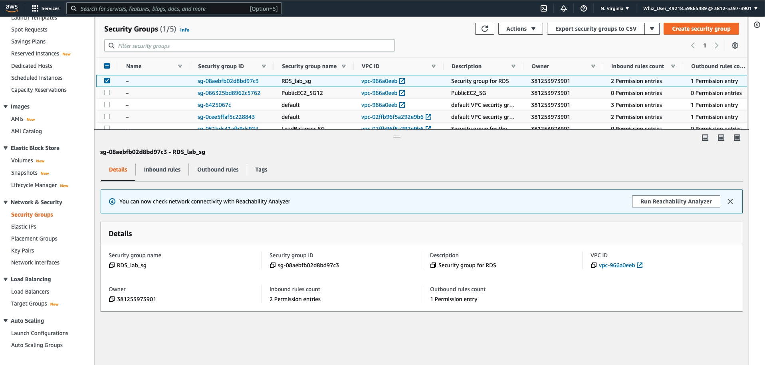
Creation of Security Group in the AWS console.

Slide 5
Task3: Creating RDS Database Instance
Navigated to RDS by clicking the services menu
DB details:
Engine option: MYSQL
Version: default
Template: Free tier (Selecting the Free tier as a template is compulsory, else database won't be created.)
DB instance identifier: mydatabaseinstance
Master username: mydatabaseuser
Master username and password: mydatabasepassword (username/password combo is used to log so I kept somewhere safe)
DB instance: I selected the (db.t2.micro-vcpu, 1GiB RAM)
Storage: I selected general purpose for this project
In the public access I selected: yes (because this will allow me as an AWS user or any anonymous user access to the data in the database).
Selected the VPC sg I created in the EC2 section.
kept everything else default and clicked create RDS

Slide 6
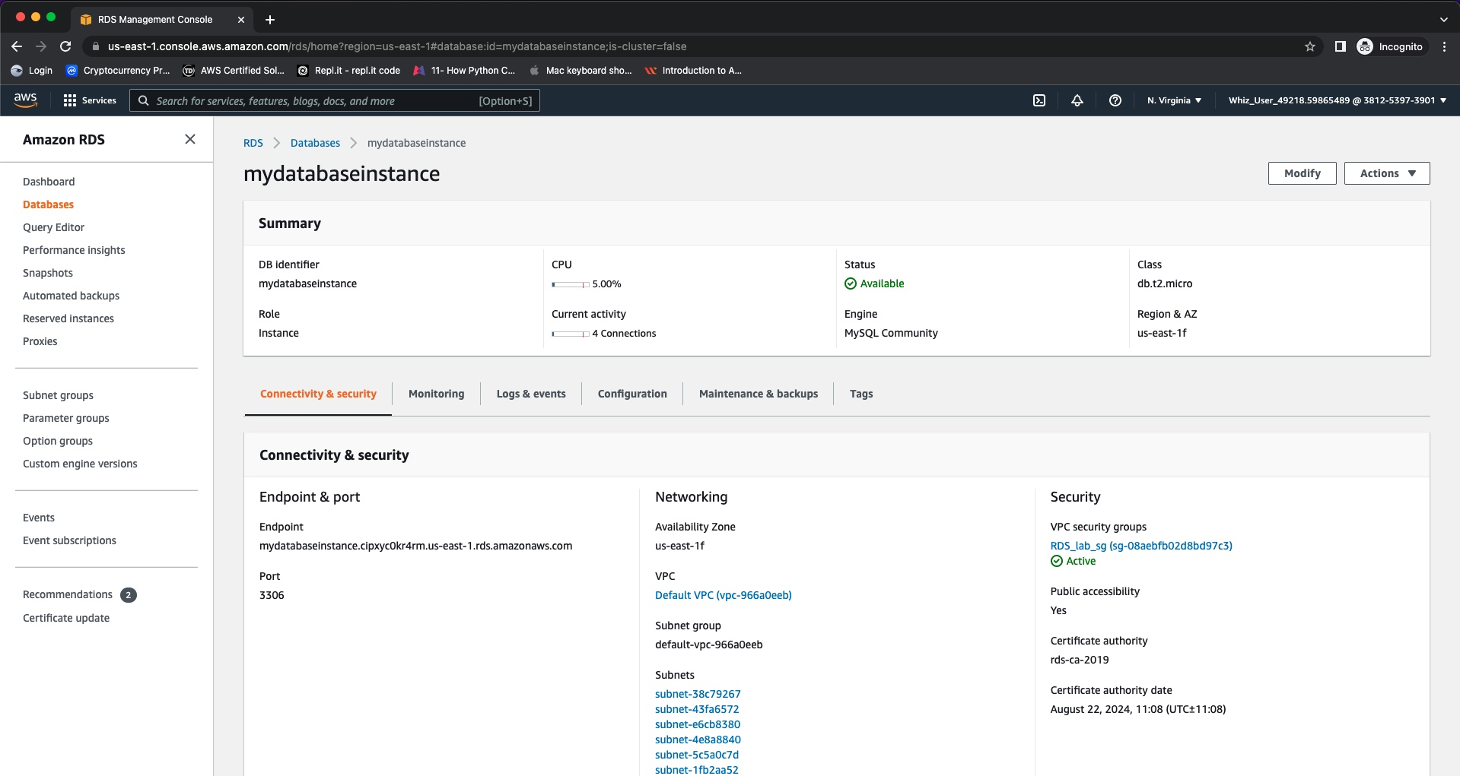
Database creation in the AWS console

Slide 7
Task 4 : Connecting to RDS Database on a DB Instance using the MySQL Workbench
in this section of the project I mainly used to connect the database on MySql db. instance using MYSQL monitor command.
I navigated to the Database and selected the one I created
Under connectivity & security section, I copied the endpoint and port.
Port:3306
Then I opened the MYSQL workbench GUI-based application.
Once I fill out the setup new connection, I tested the connection and was properly connected.
after I created a database connection in MYSQL Workbench, I went ahead and started implementing a couple database queries to interact with the database.
Next slide is the database queries screenshot.

Slide 8
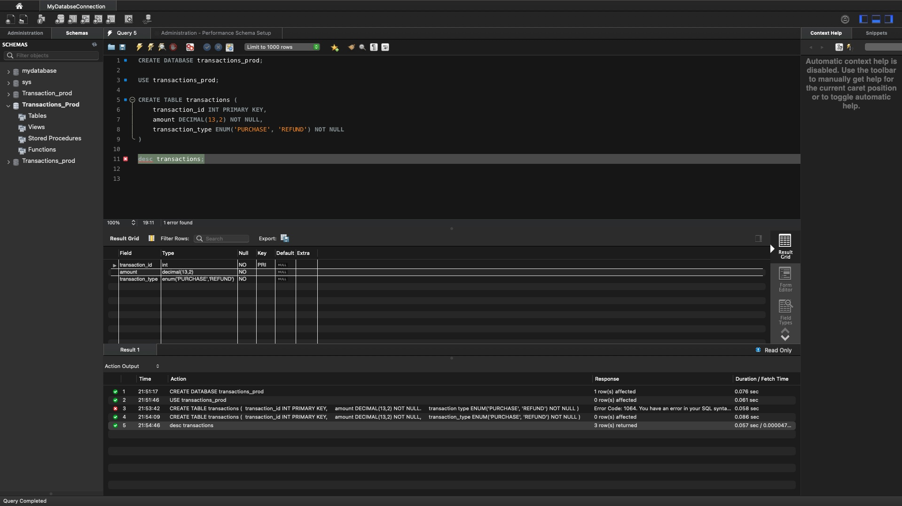
Database Queries

